Slide 1

Dark nites Defendr
Virtual Demo

Slide 2





The Team:
R (Ruslynn) Appana- u14016304@tuks.co.za
J (Jeandre) Botha - u17094446@tuks.co.za
MI (Muhammed) Carrim- u15019854@tuks.co.za
SNL (Sisa) Khoza- u15034993@tuks.co.za
CP(Christiaan)Opperman –ChristoOpperman0@gmail.com

Slide 3
The Threat: DoS & DDoS Attacks
February 2018: GitHub was flooded with 1.35Tbps of data (129.6 million PPS) in a DDoS attack.
This is one of the largest DDoS attack on record.
DoS & DDoS attacks climbed by 84%.
DoS Attack:
“An action that prevents or impairs the authorized
use of networks, systems, or applications by
exhausting resources such as central processing
units (CPU), memory, bandwidth, and disk space.”
The NIST Computer Security Incident Handling
Guide

Slide 4

The Objective:
The objectives of this project are to:
Create an intuitive system that protects any web application against DoS attacks,
Manage load balancing for back-end servers,
Dynamically add / remove bank-ends and
Provide metrics about traffic flow.

Slide 5
The Defendr: Process Cycle
Client requests back-end.
Defendr inspects packets.
Drop unwanted packets.
Log traffic data.
Assign packet to available back-end
Direct Server Return (DSR) to client

Slide 6

The Defendr: DoS Protector
Defendr monitors the rate of packet flow and number of packets originating from a client. Statistics based on origin of packet are used to discern good traffic from bad.
The packets are dropped if they exceed a predetermined limit.
Defendr’s administrator are notified by e-mail of potential attacks.
Defrendr uses XDP (eXpress Data Path) and eBPF ( eXtended Berkeley Packet Filtering) to speed up execution time and reduce cost.
All packets are logged for forensic purposes.

Slide 7
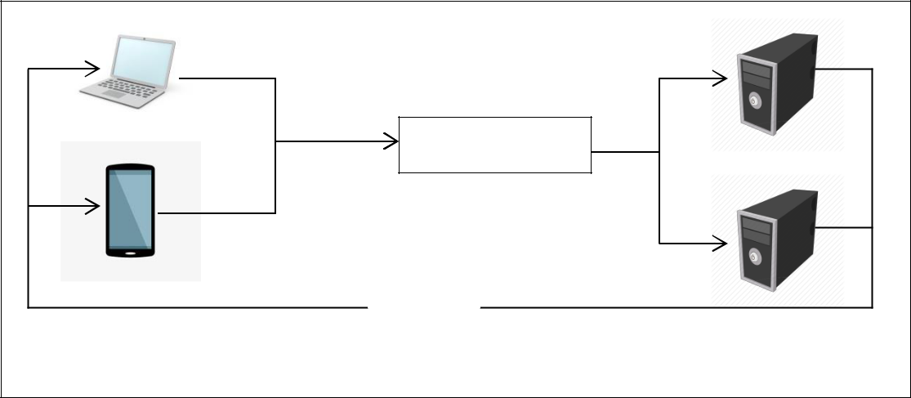
The Defendr: Load balancer & Packet Manager
Eureka is used for Back-end registration and management.
Load balancing is achieved using a round robin.
Back-ends can be dynamically added and removed.
Back-ends return responses directly to the client (DSR).
Request
Defendr
Request
Forward
Answer

Slide 8
The Defendr: Interface
The interface consist out of:
The Main Hub,
The Metrics Hub and
The Back-end Manager.
Intuitive Main Hub designed in Python with Kivy.
From the Main Hub you can navigate to the other interfaces and view system logs, manage users, black- and white listed IP addresses.
The Metrics Hub is implemented with the use of Grafana.
Metrics given by Defendr:
Heat map of traffic and
System overhead information such as CPU/swap usage.
The Back-end Manager is where users can view the back-ends and manage them.

Slide 9
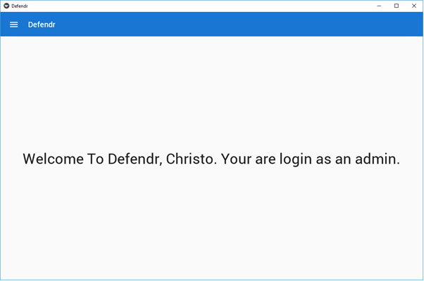
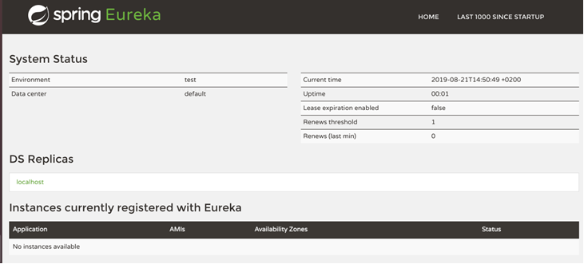
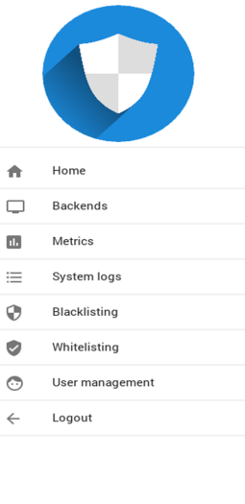
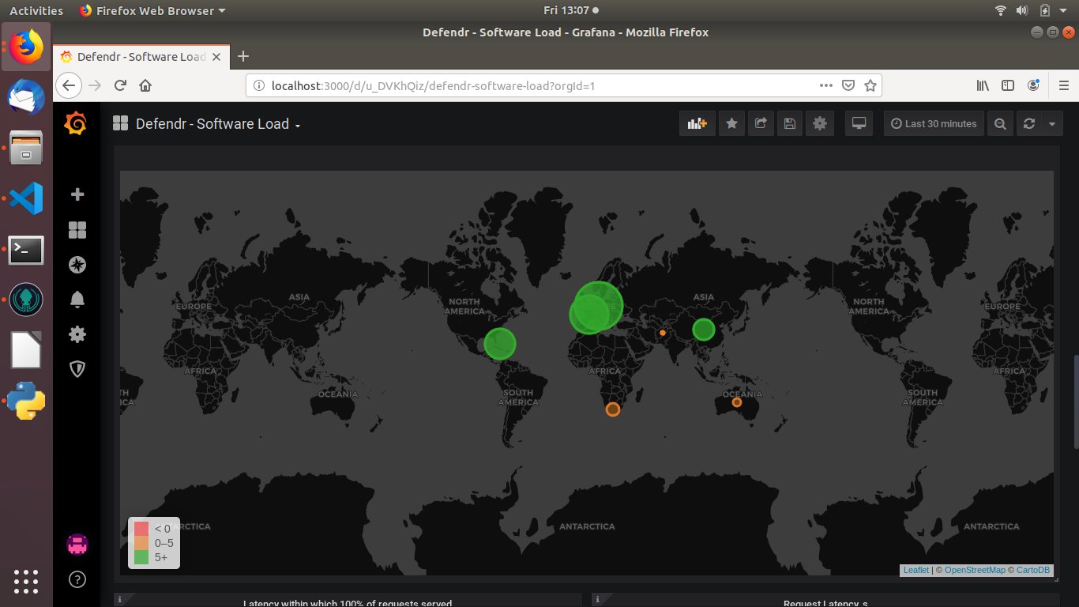
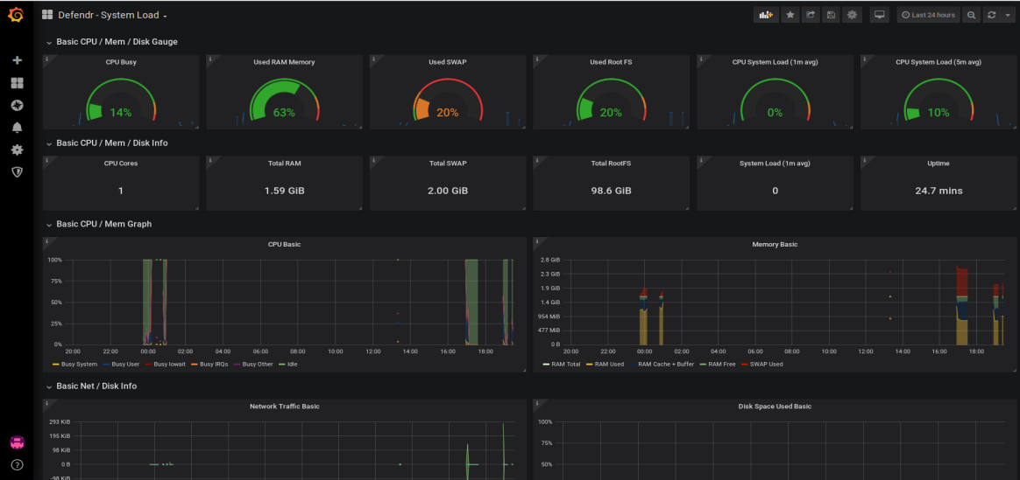
The Defendr: Interface
The main hub’s main home
The Back-end Manager
The Metrics Heat map
The Metrics System information

Slide 10
For further information please contact the developers of Defendr at: info@darknites.co.za OR www.darknites.co.za
THANK YOU!

